Slide 1

Stock & Gas Analysis
Claire, John, Nadiezhda, Monica

Slide 2

Agenda
Project Overview
Topic
Data Source
Analysis
Database Integration
Machine Learning
Dashboard

Slide 3
Project Overview - Topic
Our team was interested in analyzing stock data and discussed 3 different options:
Predict the best time to sell or buy stock
Compare S&P 500 vs. a large company (Meta, Amazon, Google, Salesforce)
See if there is a correlation between stock and gas prices
Ultimately, with gas prices reaching an all time high earlier in the year, we thought it would be interesting to see if there was any correlation between stock and gas prices. In addition to understanding if there is a correlation, we also want to use the data to answer the following questions:
How has the stock market, specifically S&P 500, changed in the last 5 years?
What drives gas prices (location, world events, politics)?
Can we predict gas or stock price behavior?

Slide 4

Project Overview - Data Source
We will be combining S&P 500 index data from Yahoo with weekly gas price data from Kaggle and EIA
S&P 500 Index (Yahoo Finance)
https://finance.yahoo.com/
Weekly Gas Prices (Kaggle & EIA)
https://www.kaggle.com/
https://www.eia.gov/finance/markets/products/prices.php
Timeframe: X-2021

Slide 5
Analysis

Slide 6
Prediction and Forecasting in R
Determine the modeling trends before starting predicting. Trend evolves in a perfectly predictable way
Convert Data to Time Series Format
Test By Using Four Modeling Trends
Linear fit
Quadratic fit
Log linear fit
Exponential fit
Determine the best fit model by AIC (Akaike’s Information Criteria) & BIC (Bayesian information criteria)
Commonly used for model evaluation and selection;
There are always four metrics used for model selection MSE AIC BIC and Mallows CP;
The smaller the AIC/BIC value, the better the model
Holt-Winters forecasting is a way to model and predict the behavior of a sequence of values over time—a time series. Holt-Winters is one of the most popular forecasting techniques for time series

Slide 7
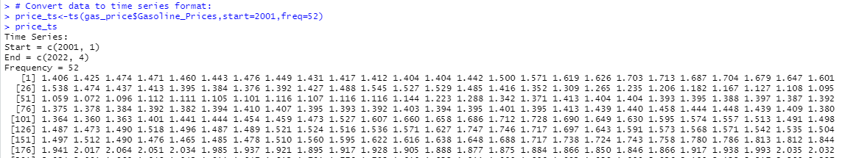
Data for Prediction
Weekly U.S. Regular All Formulations Retail Gasoline Prices Dollars per Gallon
Source: U.S. Energy Information Administration
Date: 01/2000 - 04/2022

Slide 8
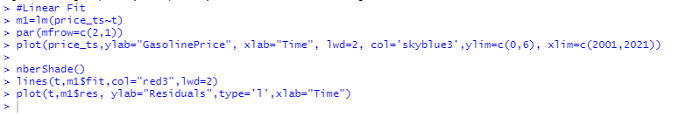

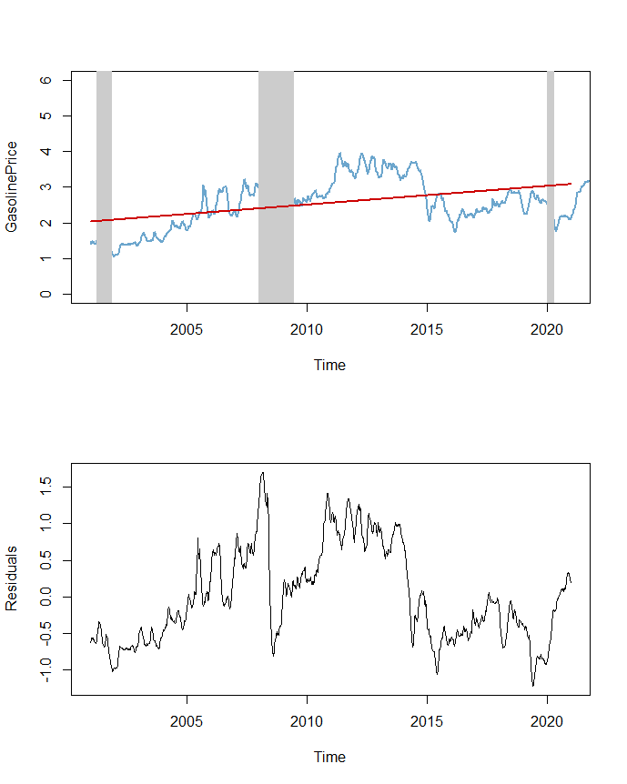
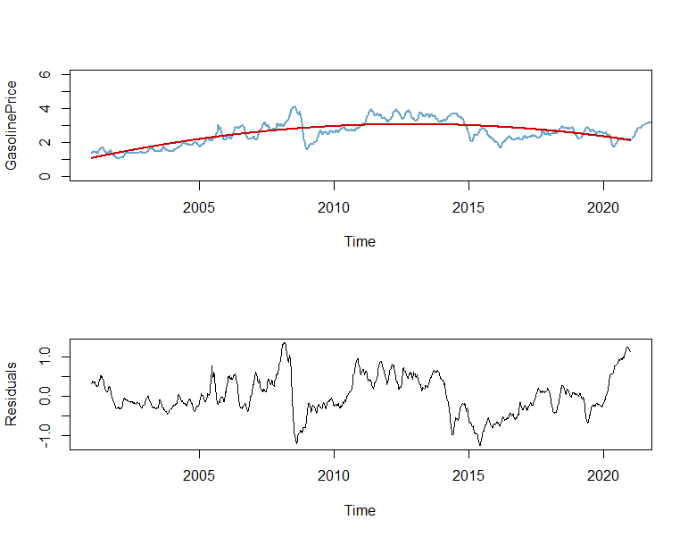
Fitting Models
Linear Fit
Quadratic Fit

Slide 9

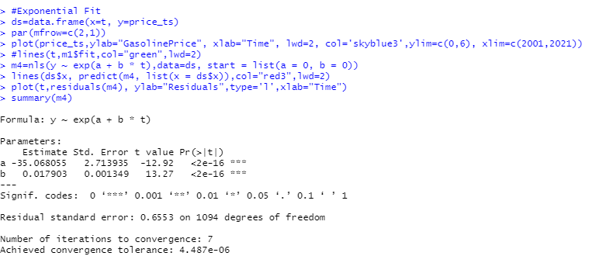
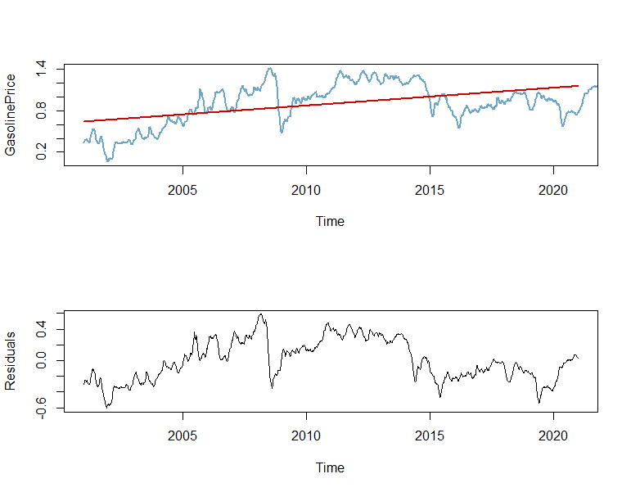
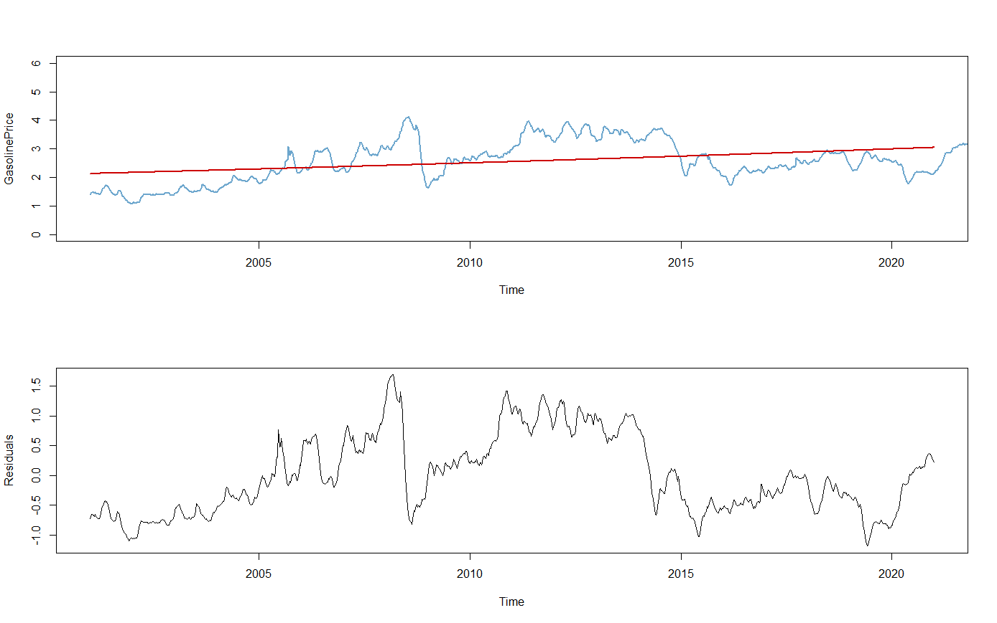
Fitting Models - cont.
Log-Linear Fit
Exponential Fit

Slide 10
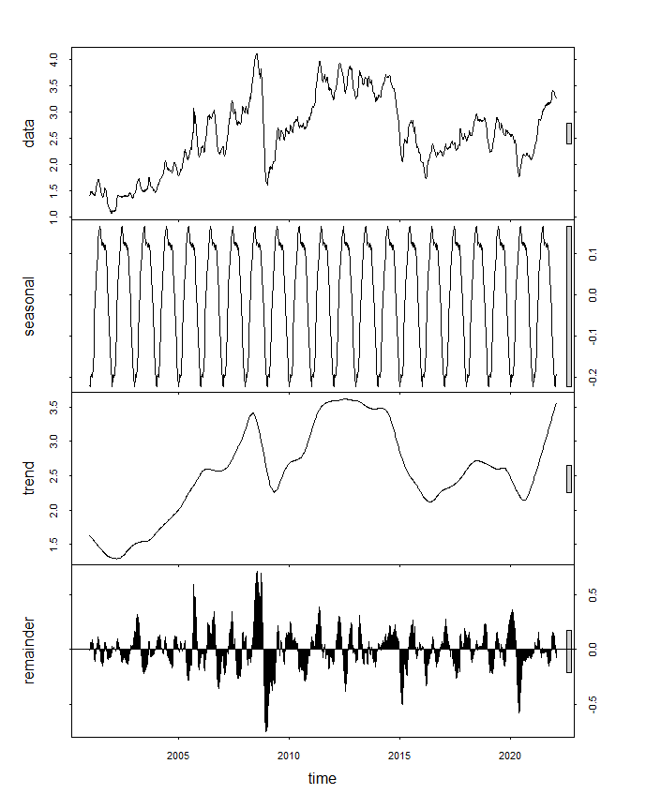
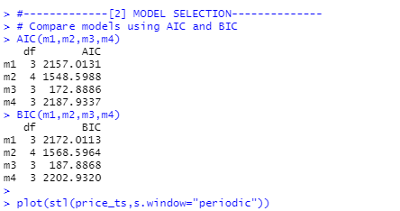
Model Selection
We compare with AIC and BIC among these four model fits.
The smaller the value returned from AIC and BIC, the better the model. From picture below, we will say Model 3 - Log-Linear Fit is the WINNER.
Trend + Seasonal Components Decoupled

Slide 11
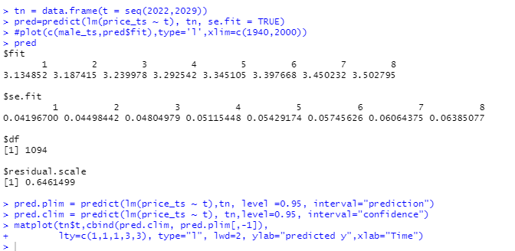
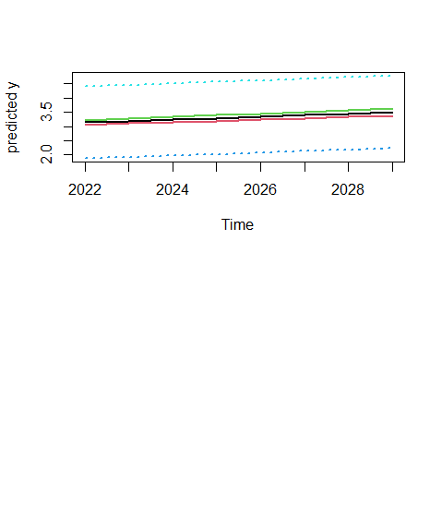
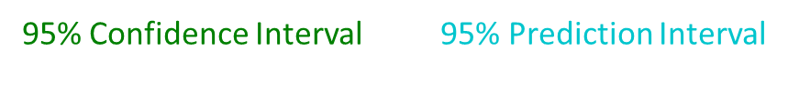
Forecasting Trend
Point Forecast: Initially at T, and want to use a trend model to forecast the h-step-ahead value.
We assume there is a linear trend:
At time T+h:
Prediction will then contain a fitted y value for each new x. Picture on the left shows the 95% confidence interval and 95% prediction interval.

Slide 12
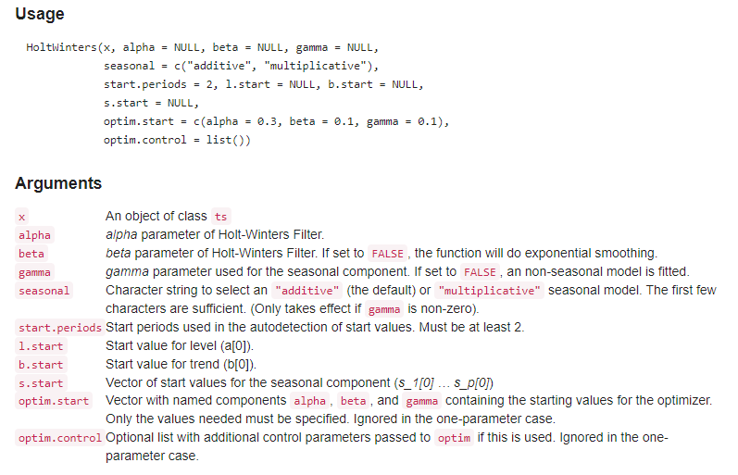
Holt-Winters Filtering
Holt-Winters :
is a model of time series behavior. Forecasting always requires a model, and Holt-Winters is a way to model three aspects of the time series: a typical value (average), a slope (trend) over time, and a cyclical repeating pattern (seasonality).
The three aspects of the time series behavior—value, trend, and seasonality—are expressed as three types of exponential smoothing, so Holt-Winters is called triple exponential smoothing. The model predicts a current or future value by computing the combined effects of these three influences. The model requires several parameters: one for each smoothing (ɑ, β, γ), the length of a season, and the number of periods in a season.
To more accurate for the forecast, we have to determine optimal parameter (alpha, beta and gamma)for Holt-Winters formula calculations.

Slide 13

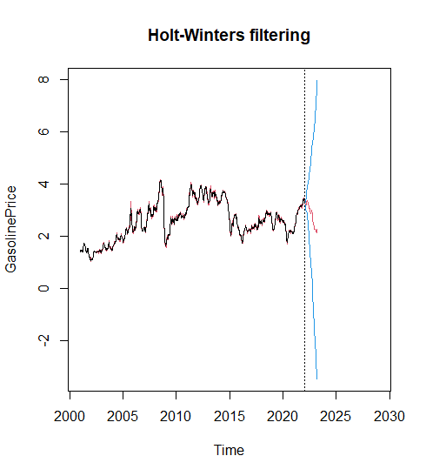

Holt-Winters Filtering
We want the forecasting to be more accurate, we set to find optimal smoothing parameters and consider seasonal Holt-Winters by using weekly price data, the forecast, which is the red line shows on the right, becomes more accurate comparing with actual data, which is the black line.
The red line after 2020 is the point forecast with 95% interval.
Interval (95%)
*** consider seasonal Holt-Winters, find optimal smoothing parameters, no need to specify alpha, beta and gamma in the r formula; for non-seasonal Holt-Winters, set gamma = F; Exponential Smoothing, set gamma = F and Beta = F

Slide 14
Database Integration

Slide 15
Draft Sample Data
Two Sample data groups:
Stock Price data:
Stock Index: S&P 500 - GSPC_Daily Stock Data 2000 - 08.2022
Oil and Gasoline Company Stocks: CVX (Chevron Corporation) & XOM (Exxon Mobil Corporation)
Potential data related to stock price:
financial market data: crude oil futures
Gasoline Price data
Weekly U.S. Regular All Formulations Retail Gasoline Prices Dollars per Gallon
Weekly U.S. Ending Stocks of Total Gasoline Thousand Barrels
Gas Price by State/Region - TX, NY, FL, CO & CA
Potential data related to gas price:
Trading data: importing amounts
Production market data: crude oil price and production for gasoline

Slide 16
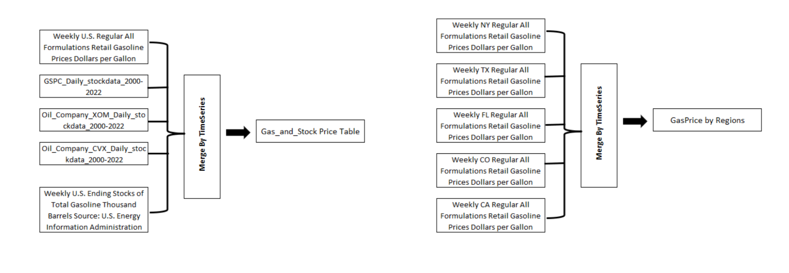
Data Integration

Slide 17
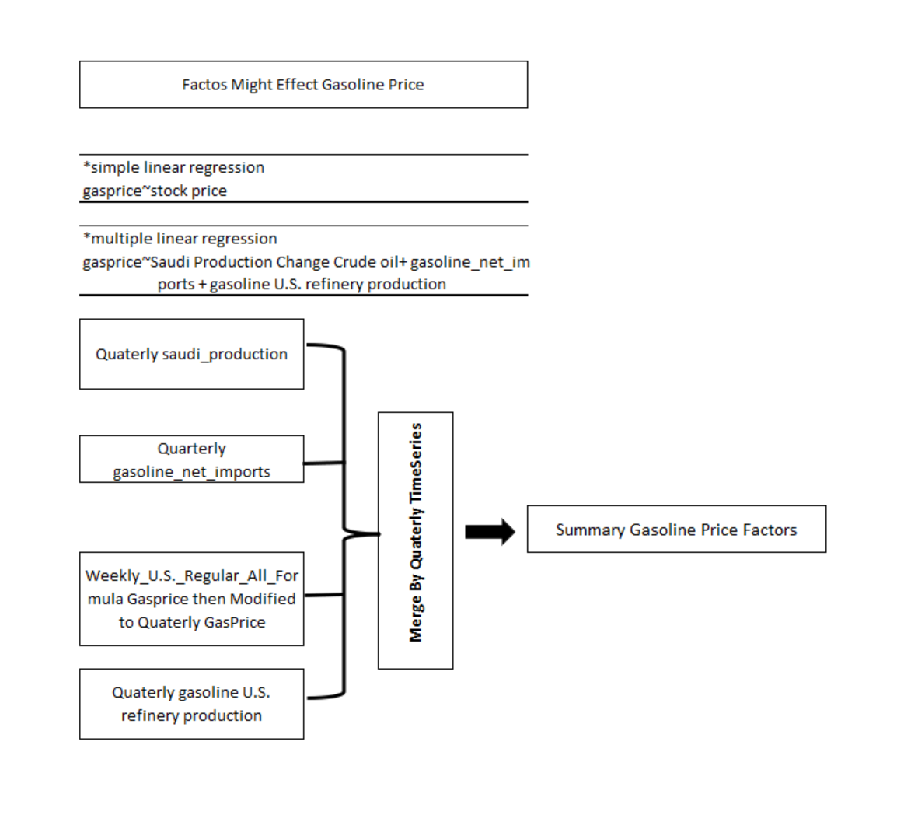
R Analysis Data

